Slide 1

AC PROMOTION BUMP ASSIGMENT
Kaan Turgay

Slide 2




Introduction & Objectives
Evaluate impact of promotional activities
Provide actionable insights
Comprehensive analysis framework
Derive strategic recommendations to optimize future promotional strategies and campaigns
Combine descriptive, clustering, and predictive modeling approaches to gain a holistic understanding of promotional dynamics
Analyze sales data to understand the effects of promotional campaigns on retail sales performance
This study aims to equip the client with data-driven insights to guide their promotional planning and execution, ultimately driving improved sales and marketing performance.

Slide 3
Data Overview
Daily sales transactions
The data includes 1,873,618 daily sales transactions across 340 stores and 317 products.
Product hierarchies
The data provides information on the product portfolio and its structure.
Realized post-promotion sales
The data captures the realized sales performance during promotional periods.
Promotion schedules
The data includes information on the timing and duration of promotional activities.
Time period
The data spans 7 months, from January to July 2015.

Slide 4



Data Preparation
Promotion Calendar Cleaning
Promotion Tagging
Weekly Performance Panels
Strict label validation, robust date parsing, start/end date consistency checks, duration checks to ensure 14-day windows
Merge_asof operation to align sales data with promotion start dates, range filter on end dates to keep within promo windows, new fields: PromoPeriod and IsPromotion
Store-product performance panels, calculated average weekly non-promo sales per store and per product, negligible null ratios
The data preparation process ensured clean, normalized, and well-structured data for comprehensive promotional analysis.

Slide 5


Seasonal & Day-of-Week Effects
Top Sales Days
Higher Basket Sizes
Elevated Return Rates
Fridays and Sundays are the top sales days, accounting for the highest total units sold.
Customers tend to have higher average basket sizes on Fridays and Saturdays, reaching 3.15 and 3.29 units per transaction respectively.
The return rate is slightly higher on weekends, peaking at 0.644% on Saturdays and 0.593% on Fridays.
The analysis reveals distinct patterns in sales and returns by day of the week, with weekends and Fridays driving the highest volumes and larger basket sizes, but also slightly elevated return rates. These insights can inform promotional timing and operations planning to capitalize on the weekly rhythms of consumer demand.

Slide 6



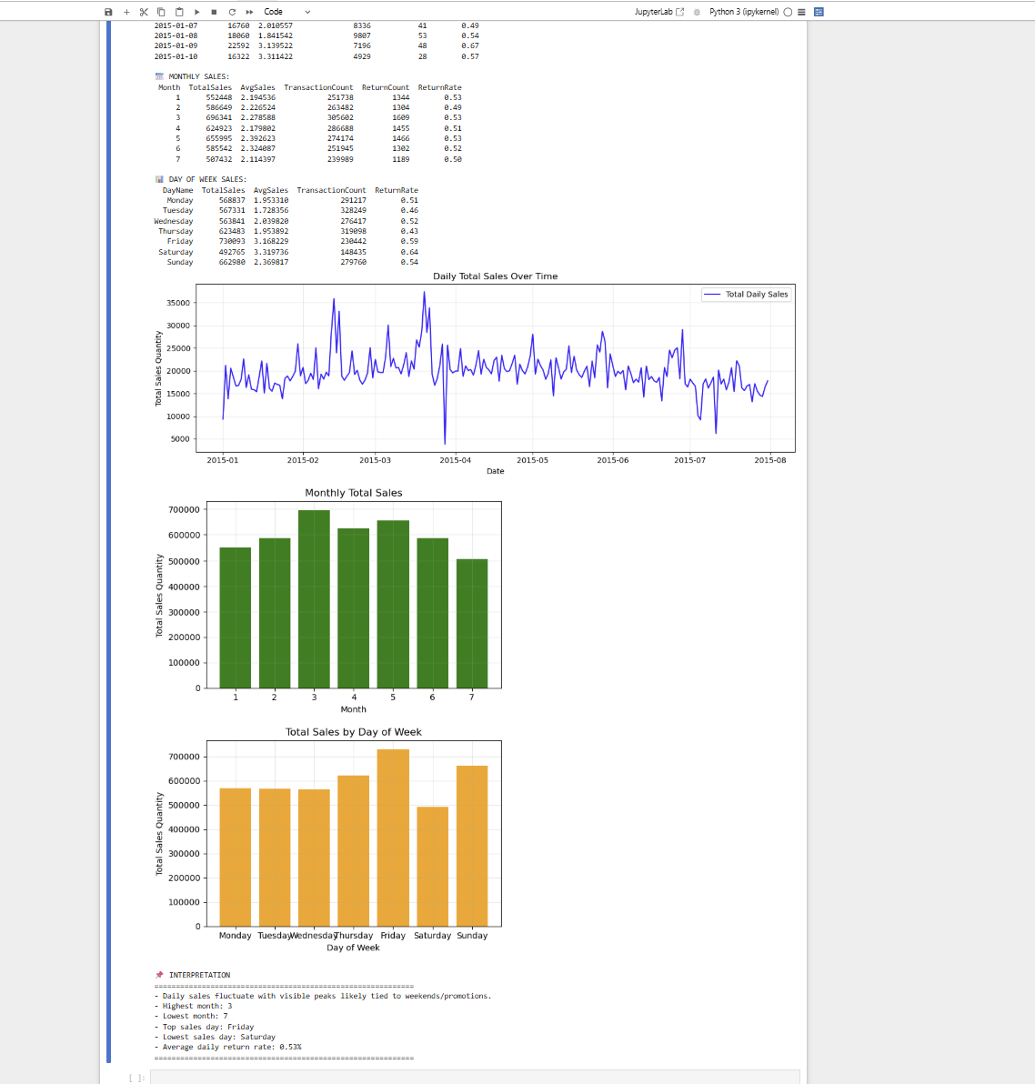
Sales Trends Over Time
Daily
Monthly
19,855 average units sold per day
Seasonal sales peak in March-May, decline in July
Weekly
Fridays and Sundays highest sales days

Slide 7
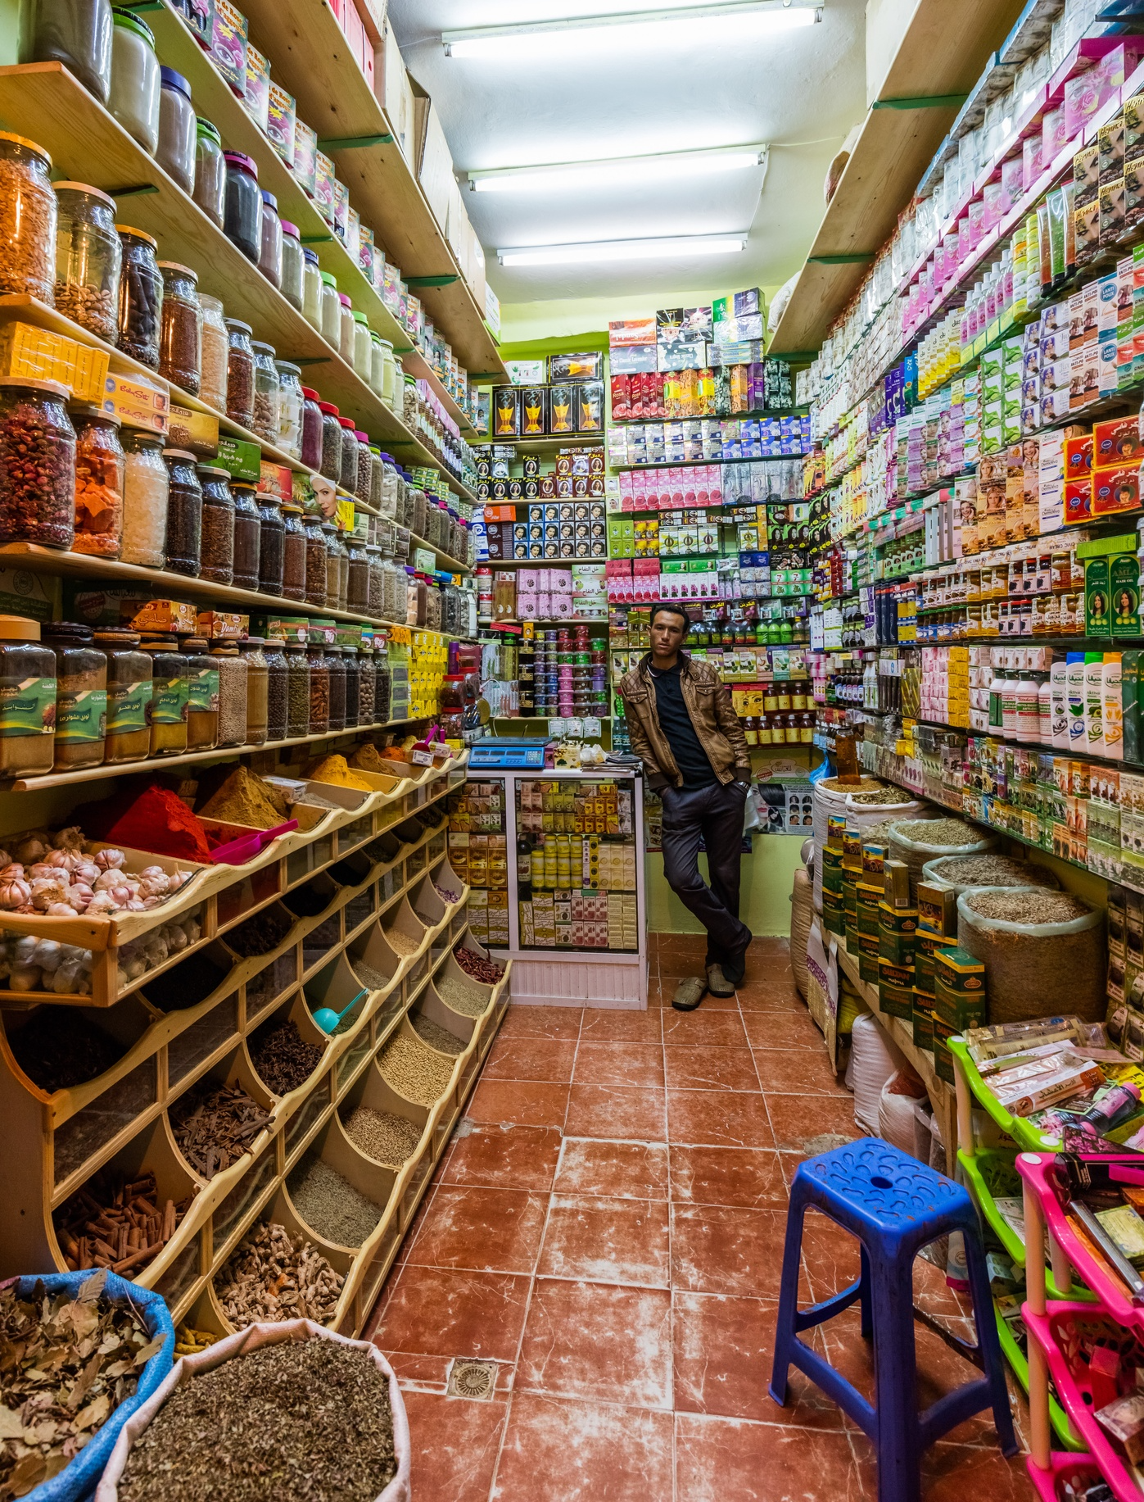
Store-Level Performance
The analysis reveals that retail sales are highly concentrated in a few top-performing stores, with a long tail of lower-volume outlets. The data also shows notable variations in customer return rates across different stores, with some locations exhibiting significantly higher anomalies.
6.1 Store Performance — Sales Leaders
Store 331: 54,059 units across 17,470 transactions (AvgSales 3.09, ReturnRate 0.25%). Store 276: 46,602 units across 15,414 transactions (AvgSales 3.02, ReturnRate 0.36%). Store 2: 41,321 units (AvgSales 3.27, ReturnRate 0.44%). Store 281: 38,328 units (ReturnRate 0.64%). Store 98: 38,187 units (AvgSales 3.71, ReturnRate 0.56%).
6.2 Store Performance — Return Rate Outliers
High return‑rate stores include Store 165 (1.26%), Store 124 (1.21%), Store 208 (1.09%), Store 94 (1.09%), and Store 323 (1.06%).

Slide 8
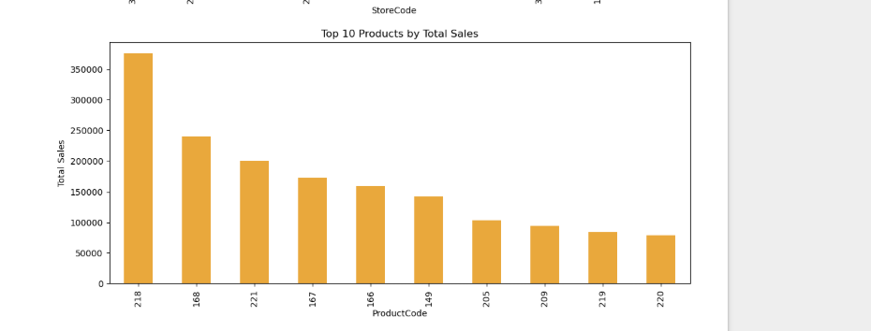
Product-Level Performance
Pareto-like product sales distribution
A small subset of products account for a disproportionately large share of total sales
Top-selling product
Product 218 generated 375,778 units in sales, or 20.1% of the total sales volume
Top 5 products account for majority of sales
The top 5 products (218, 168, 221, 167, 166) accounted for 57.7% of the total sales

Slide 9








High vs Low Performing Products
Total Sales and Return Rate across Product Clusters
85%
45%
15%
100%
Fast Movers
Medium Movers
Slow Movers
Extreme Outliers

Slide 10
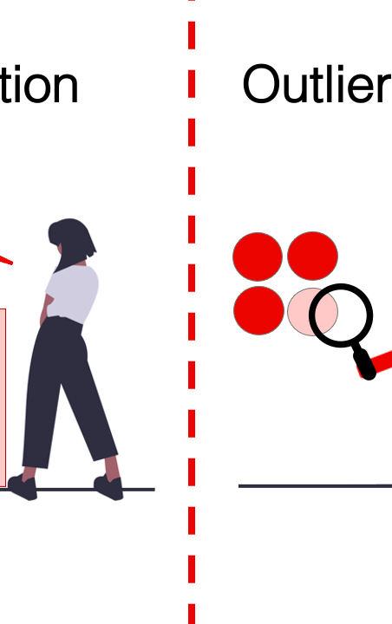
Anomalies & Outliers
The analysis identified a significant number of anomalies and outliers in the sales data, with 8.7% of records (163,898) classified as outliers using the IQR method. This includes 16,587 extreme positive outliers with the highest single sale of 912 units, as well as 9,669 extreme negative outliers with the lowest return of -60 units.
IQR MethodThe IQR Method detects anomalies by measuring the spread of the middle 50% of data (between Q1 – 25th percentile and Q3 – 75th percentile).The Interquartile Range (IQR) is defined as:𝐼𝑄𝑅=𝑄3−𝑄1IQR=Q3−Q1Any value below Q1 – 1.5 × IQR or above Q3 + 1.5 × IQR is flagged as an outlier.This method is robust to skewness and works well with retail sales data, where extreme spikes or drops often distort averages.Applied here to remove abnormally high or low sales points (e.g., reporting errors, rare events), ensuring that clustering and predictive models rely on stable patterns.

Slide 11
Key Descriptive Insights
Recurring Sales Spikes
Daily sales exhibit recurring spikes, likely due to weekends and promotional periods.
Seasonal Sales Trends
Monthly sales patterns show a seasonal arc, peaking in Q1-Q2 and cooling in Q3.
Weekday vs. Weekend Differences
Fridays and Sundays are the top sales days, with higher average basket sizes. Return rates are slightly elevated on weekends.
Concentrated Store & Product Performance
Sales are highly concentrated in a few high-performing stores and products, with a long tail of low-volume outlets and SKUs.
Anomalous Returns
8.7% of records are identified as outliers, including extreme positive and negative sales spikes.

Slide 12
KPI SUMMARY
Metric | Value
Date Range | 01/01/2015 to 31/07/2015
Total Days | 212
Avg Daily Sales | 19855.33
Avg Daily Returns | 45.61
Total Stores | 340
Store Sales Range | 0 - 54059
Avg Store Sales | 12380.38
Avg Store Return Rate | 0.52%
Total Products | 317
Product Sales Range | -3 - 375778
Avg Product Sales | 13278.64
Avg Product Return Rate | 2.60%
Outliers (%) | 8.7%
Extreme Positive Count | 16587
Extreme Negative Count | 9669
IMPORTANT KPI

Slide 13





Control Charts (SPC)
Daily Sales Range (X-bar)
Weekly Sales Volatility (Moving Range)
Monthly Sales Seasonality
Outliers Detected

Slide 14
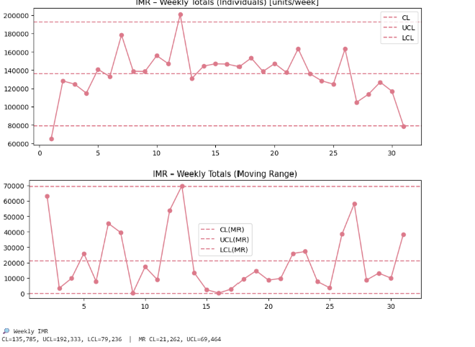
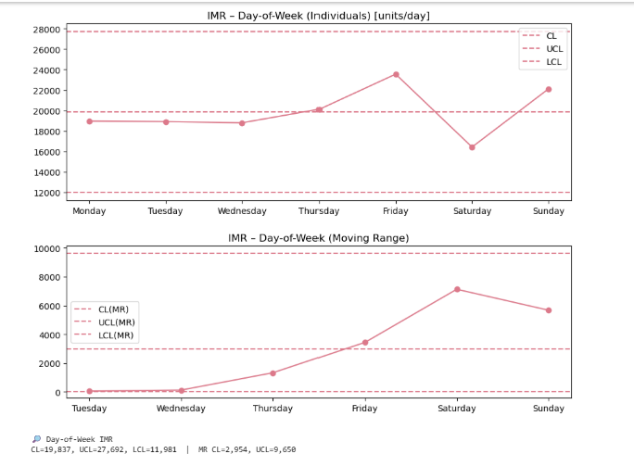
10.2 Day‑of‑Week IMR (units/day)
I‑chart limits: CL = 19,837; UCL = 27,692; LCL = 11,981. All weekdays lie within limits. Friday is highest (~24k), Saturday lowest (~16k), with Sunday rebounding (~22k). MR‑chart limits: MR‑CL = 2,954; MR‑UCL = 9,658. Day‑to‑day swings are within control
10.3 Weekly Totals IMR (units/week)
I‑chart limits: CL = 135,785; UCL = 192,333; LCL = 79,236. Most weeks inside limits; week 1 dips near/below LCL; peaks around weeks 10–12 ride near UCL. MR‑chart limits: MR‑CL = 21,262; MR‑UCL = 69,464. Volatility spikes are visible but in control overall.
10.4 Monthly Totals IMR (units/month)
I‑chart limits: CL = 601,333; UCL = 776,398; LCL = 426,268. All months inside limits (March near UCL; July lower side). MR‑chart limits: MR‑CL = 65,824; MR‑UCL = 215,848. Month‑to‑month changes well‑contained.

Slide 15




Clustering Methodology
K-Means Clustering Approach
Clustering Criteria
Product Clustering Results
Store Clustering Results
Categorized products and stores into Fast, Medium, and Slow groups based on their average weekly non-promotional sales volumes
All 340 stores were clustered, with 182 classified as Slow, 123 as Medium, and 35 as Fast performers
Used K-Means algorithm to segment products and stores into 3 distinct clusters: Fast, Medium, and Slow based on average weekly non-promotional sales
316 out of 317 products were clustered, with 271 classified as Slow, 39 as Medium, and 6 as Fast movers
The K-Means clustering approach allowed us to identify distinct segments of products and stores based on their non-promotional sales performance. This segmentation will enable more targeted promotional strategies and resource allocation to optimize campaign effectiveness.

Slide 16
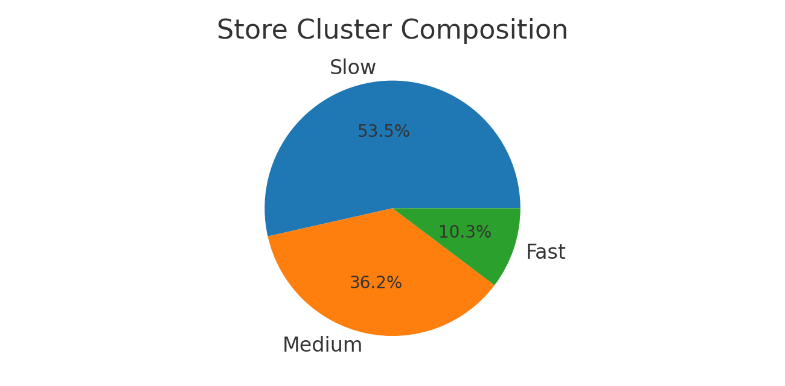
Store Clusters
The store performance analysis reveals that the majority of stores (182 out of 340) are classified as Slow, with the smallest group being the Fast stores (35). This uneven distribution highlights the significant differences in sales productivity across the retail network.
StoreCode | Total Non-Promo Sales | Product–Weeks (Non-Promo) | Avg Weekly Sales per Product
1 | 10,409 | 3,007 | 3.46
2 | 33,959 | 4,261 | 7.97
3 | 6,847 | 2,275 | 3.01
4 | 10,552 | 3,019 | 3.50
5 | 8,551 | 2,711 | 3.15
Cluster centers (original units: avg weekly sales per product, non‑promo): Slow ≈ 2.627; Medium ≈ 3.936; Fast ≈ 6.491. Suggested cutoffs (original units): Slow < ~3.281; Medium ~3.281-5.213; Fast ≥ ~5.213. Composition: Slow 182; Medium 123; Fast 35.

Slide 17
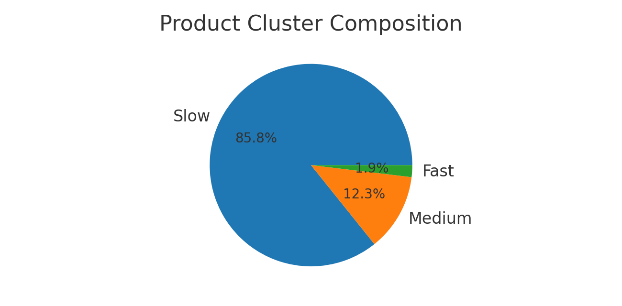
ProductCode | Total Non-Promo Sales | Store–Weeks (Non-Promo) | Avg Weekly Sales per Store
1 | 9,447 | 2,662 | 3.55
2 | 7,115 | 2,358 | 3.02
3 | 5,181 | 2,183 | 2.37
4 | 6,335 | 2,184 | 2.90
5 | 7,633 | 2,721 | 2.81
Cluster centers (original units: avg weekly sales per store, non‑promo): Slow ≈ 1.4; Medium ≈ 6.35; Fast ≈ 21.02. Suggested cutoffs (original units): Slow < ~3.875; Medium ~3.875-13.684; Fast ≥ ~13.684. Composition: Slow 271; Medium 39; Fast 6.
Product Clusters
The product portfolio analysis reveals a highly skewed distribution of sales, with a small subset of products driving the majority of revenue. The majority of products, 271 out of 316 (86%), are classified as Slow movers, indicating that they generate low sales volumes.

Slide 18



Promo vs Non-Promo Behavior
Slow products show highest promotional uplift
Slow stores benefit the most from promotions
Slow products benefit the most from promotions, with an average uplift of +10.2% during promo periods.
Slow stores see the highest relative promotional uplift at +10.6%, compared to +9.2% for Medium stores and +5.6% for Fast stores.
Fast products exhibit limited or negative uplift
Promo effectiveness varies by store and product speed
Fast-moving products have an average promotional uplift of -1.8%, indicating limited or even negative response to promotions.
The analysis reveals a clear pattern where promotional impact is most significant for slow-moving products and stores, but limited or negative for fast-moving segments.
The insights from the clustering analysis highlight the importance of tailoring promotional strategies based on the underlying speed and performance of stores and products. Slow-moving segments exhibit the highest responsiveness to promotions, suggesting targeted investment could yield the greatest returns, while fast-moving categories may require alternative approaches like assortment optimization and loyalty programs.

Slide 19
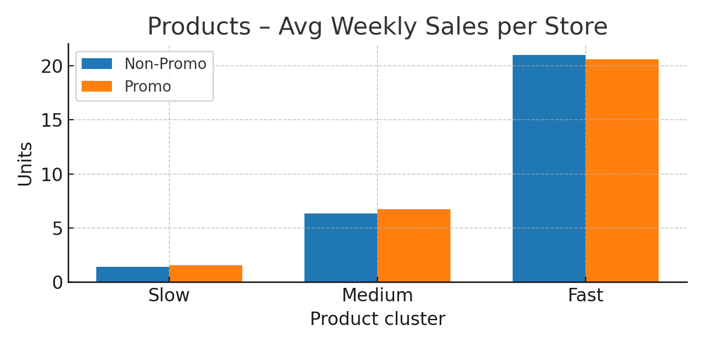
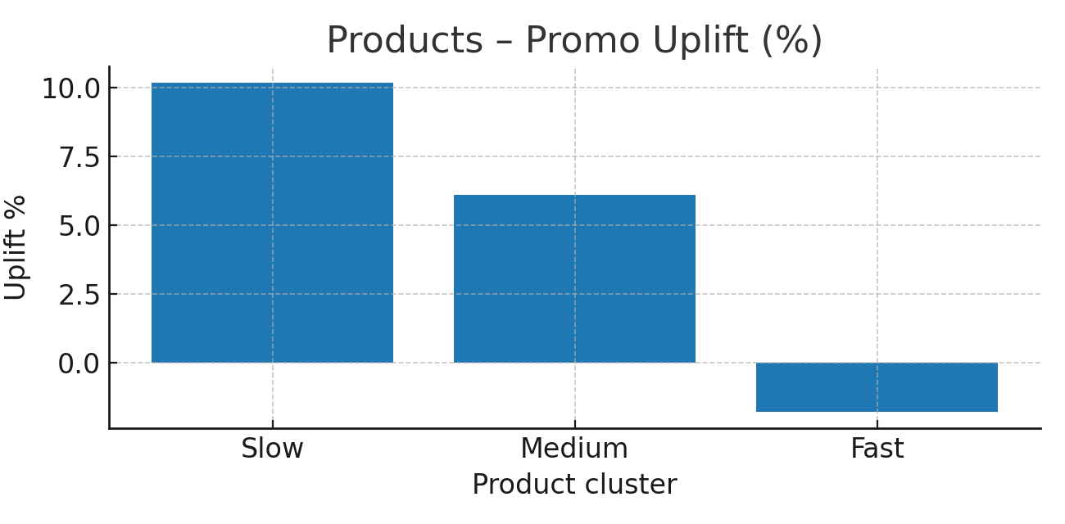
Product Results
Cluster | Non‑Promo Avg | Promo Avg | Uplift Abs | Uplift %
Slow | 1.4 | 1.54 | 0.14 | 10.2
Medium | 6.35 | 6.74 | 0.39 | 6.1
Fast | 21.02 | 20.63 | -0.39 | -1.8
Elasticity & Baseline • Slow movers = highest promo responsiveness • Fast movers = limited or negative effects
Promotions Boost Weak Segments • Low-sales products attract attention & demand • Low-throughput stores gain footfall & awareness
Diminishing Returns • Fast products/stores = low marginal gains • Risk of substitution & saturationP
Managerial Implications • Focus promos on slow products/stores (higher ROI) • Fast segments → use loyalty, cross-selling, innovation • Apply differentiated promo strategy (not one-size-fits-all)
Store Results
Cluster | Non‑Promo Avg | Promo Avg | Uplift Abs | Uplift %
Slow | 2.63 | 2.91 | 0.28 | 10.6
Medium | 3.94 | 4.3 | 0.36 | 9.2
Fast | 6.49 | 6.86 | 0.37 | 5.6

Slide 20
Standard Clustering Insights
Slow-Mover Dominance
The product portfolio is heavily skewed toward Slow-moving items, representing 86% of the total.
Targeted Promotion Focus
Focusing promotional efforts on the Medium and Fast clusters can yield higher incremental returns compared to broad-based discounts.
Optimizing Slow Movers
Slow products may benefit more from price optimization, assortment changes, or targeted marketing rather than broad-based discounts.
Store Performance Skewness
Store performance is also skewed, with the majority (54%) categorized as Slow, requiring operational improvements or assortment adjustments.
Prioritizing Fast and Medium Stores
Promotions should be prioritized for Fast and Medium stores, where incremental uplift is higher.

Slide 21
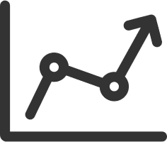


Bonus Methodology
Promo-Period Clustering
New Cluster Centers
Cluster Transition Matrix
Uplift Analysis
Clustering analysis focused solely on sales during promotional periods, to identify distinct promo-specific store and product segments
Promotional clustering yielded different cluster centers compared to the baseline sales clusters, reflecting the distinct sales dynamics under promotions
Analyzed how stores and products shifted between clusters when evaluated under promo-only sales vs. the full non-promo period
Calculated the mean sales uplift and difference for each cluster transition, to quantify the impact of promotions on different performance segments
The bonus promo-focused clustering provides a complementary lens to the standard analysis, revealing how promotions reshape the underlying sales distribution and highlighting the elastic response of certain segments to promotional activities.

Slide 22
Promo-Speed Clusters
(Bonus)
This bonus section complements the main clustering analysis by applying K-Means clustering exclusively to promotional sales periods. Unlike the baseline clusters (Slow, Medium, Fast), which were derived from non-promo sales, here we estimate new clusters under the distinct sales dynamics of promotions. These clusters are labeled as SlowPromo, MediumPromo, and FastPromo.
Store and Product Clustering
Baseline Cluster | SlowPromo | MediumPromo | FastPromo
Slow | 253 | 2 | 0
Medium | 4 | 34 | 1
Fast | 0 | 0 | 6
Transition patterns: many Medium stores/products remain MediumPromo, but a significant share shift into FastProm
Implications: highlights which groups are highly promotion-sensitive vs. those with stable demand
Value of dual clustering: shows how promo campaigns reconfigure sales speed thresholds and reveal hidden elasticities
Promotions redefine cluster boundaries → SlowPromo, MediumPromo, FastPromo differ from baseline clusters

Slide 23




Bonus Clustering Insights
Promo-Based Clustering Reveals Shifting Sales Dynamics
SlowPromo, MediumPromo, and FastPromo Clusters
Transition Matrix Shows Cluster Shifts During Promos
Clustering solely on promotional sales data shows distinct product and store segments with different responsiveness to promotions, providing a new perspective on sales patterns.
The promo-based clustering identified 3 distinct segments for both products and stores, with thresholds differing from the standard non-promo clustering.
Most Slow and Medium baseline products/stores shifted to higher promo-speed clusters during promotional periods, indicating a reconfiguration of the sales landscape.
Targeted Promotion Strategies for Segmented Portfolios
The dual-clustering approach enables more tailored promotional plans, prioritizing the most responsive SlowPromo segments while exploring alternatives for less elastic FastPromo entities.
The bonus clustering analysis provides a novel perspective on promotional dynamics, revealing how campaigns can reshape the relative thresholds that define product and store sales velocities. This insight can guide more nuanced promotional strategies, allocating resources toward the most responsive segments while exploring alternative approaches for less elastic high-speed categories.

Slide 24
Modeling Framework
Two-stage Modeling Approach
Baseline model for non-promotional weeks and Uplift model for promotional weeks
Regression-based Models
Leveraging linear regression (OLS) for simplicity and interpretability
Numerical Features
Lags, moving averages, seasonality to capture temporal patterns
Categorical Features
Item/store clusters, product hierarchy, promotion indicators
Modeling Goals
Estimating promotional uplift and identifying key drivers

Slide 25



Feature Engineering
Promo Flags
Lag Features
Store & Product Interactions
Indicators of whether a sales record fell within a promotion period (NoPromo, Promo1-Promo6)
Past sales from 1, 2, 4, 8, and 12 weeks ago to capture temporal dynamics
Interaction terms between promo indicators and store/product clusters to model differentiated promotional responses
The feature engineering process created a comprehensive set of variables, including promo flags, lagged sales, and interactions between promotions and store/product characteristics. This allowed the predictive models to better capture the complex, non-linear patterns in how promotions impact retail sales.

Slide 26
Predictive Insights
Linear Model: Underperforms
XGBoost: Stronger Non-Linear Patterns
The simple linear regression model exhibited severe underestimation, with a negative R² of -60.874, indicating it is not suitable for capturing the complex nonlinear promotional effects.
The XGBoost two-stage uplift model achieved an R² of 0.328 overall, performing better on Fast product and store clusters (item R²=80.98%, store R²=77.25%) compared to Medium and Slow segments.
HistGradientBoosting (Poisson Log-Uplift): Best Overall Accuracy
HB (Hierarchical Bayesian): Advanced Approach
The Hierarchical Bayesian uplift model showcased an advanced technique to estimate promotional impacts, achieving improved accuracy compared to the other methods.
The HistGradientBoosting Poisson + Log-Uplift model delivered the best overall WAPE of 75%, with balanced performance across all item and store clusters, and the lowest error rates in Fast segments.

Slide 27
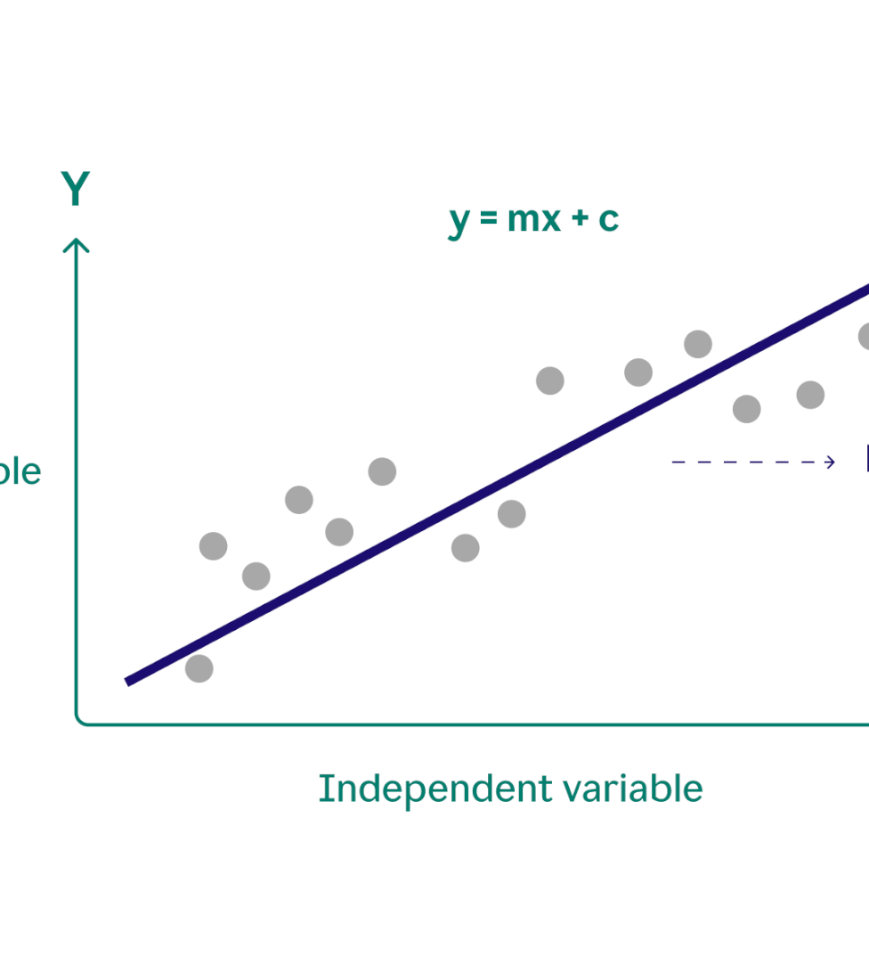
Linear Model
The analysis presented a two-stage modeling approach, where the first stage involved developing a baseline linear regression model to capture non-promotional sales drivers. This model achieved an R-squared of 0.331, indicating it could explain 33% of the variance in non-promotional demand. The second stage focused on building a linear uplift model to estimate the incremental impact of promotions, but this model struggled to generalize, only capturing 9% of the variance in promotional uplifts.
The simple linear regression model exhibited severe underestimation, with a negative R² of -60.874,

Slide 28
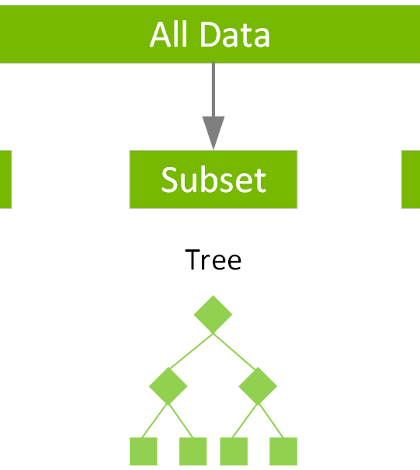
XGBoost Model
The XGBoost model was a key component of the predictive modeling framework, demonstrating its ability to capture the non-linear patterns in the promotional data. This advanced tree-based algorithm outperformed the simpler linear regression model, achieving an R² of 0.328 on the test data for the Promo5 and Promo6 campaigns, compared to a negative R² for the linear model.

Slide 29
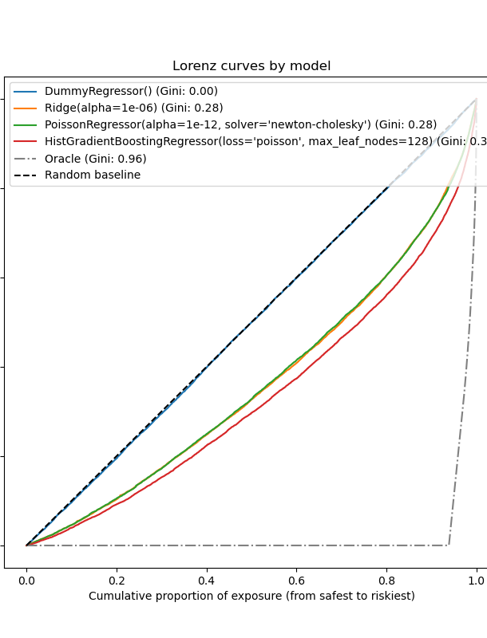
HistGradientBoosting (Poisson Log-Uplift)
The HistGradientBoosting (Poisson Log-Uplift) model was chosen as a key component of the predictive modeling framework due to its ability to handle the unique distribution and characteristics of the promotional sales data. This approach combines a Poisson regression baseline model to capture the underlying sales patterns during non-promotional periods, with a separate log-uplift model to predict the incremental sales lift during promotions. The log-uplift target helps to stabilize the predictions and balance accuracy with stability, outperforming earlier OLS uplift and squared-error models.

Slide 30
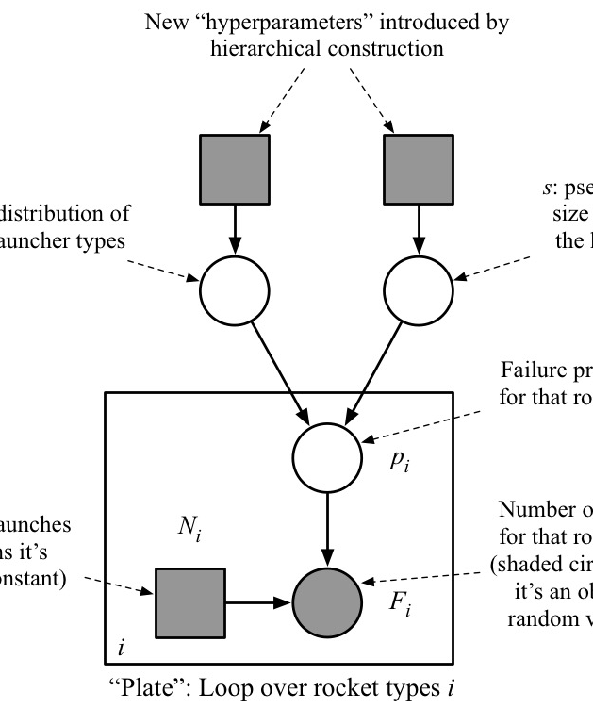
HB (Hierarchical Bayesian) Model
The Hierarchical Bayesian (HB) model represents an advanced approach to promotional uplift forecasting, delivering improved accuracy and robustness compared to previous techniques. By modeling the incremental promotional effect as a deviation from the baseline demand, the HB model is able to capture the complex, non-linear patterns inherent in retail sales data.

Slide 31
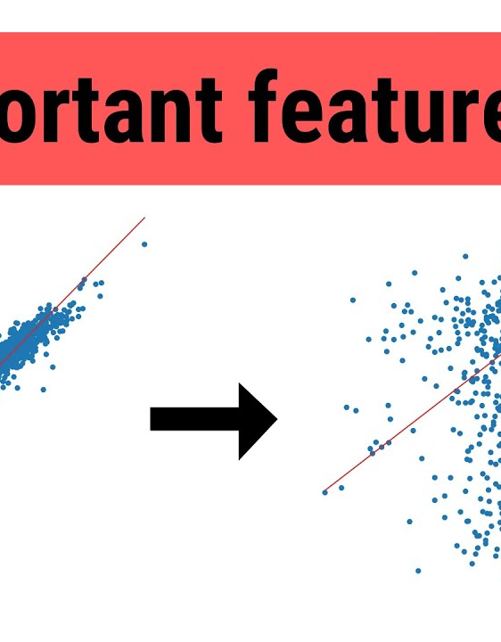
Feature Importance (Permutation Importance)
The feature importance analysis identifies the key drivers of sales uplift during promotional periods. Using permutation importance, the team quantifies the relative contribution of each feature in predicting the incremental sales boost from promotions.

Slide 32


Model Comparison
Model
R²
WAPE
Linear OLS Uplift
-0.608
112.18%
XGBoost Two-Stage Uplift
0.328
85.78%
HistGradientBoosting (Squared Error)
0.413
80.65%
HistGradientBoosting Poisson + Log-Uplift
0.296
75.00%
*Based on the model performance metrics reported in the context provided.

Slide 33


Limitations & Challenges
Sparse Sales Distribution
Extreme Outliers
Overfitting Risks
The dataset is dominated by slow-moving items, with 86% of products selling less than 3.875 units per store-week on average during non-promo periods. This sparsity poses challenges for accurately modeling sales patterns.
The data contains notable outliers, including single-day spikes of up to 912 units and extreme negative values down to -60 units. These anomalies can skew model performance and need to be carefully handled.
The baseline model achieves very high in-sample fit (R² ≈ 0.95+), raising concerns about overfitting to the training data. The model's performance drops significantly when evaluated on the hold-out Promo5-6 data, indicating poor generalization.
The data characteristics, including sparse sales distribution, extreme outliers, and overfitting risks, present significant challenges for accurately modeling promotional impacts. Careful data preparation, feature engineering, and model validation will be crucial to develop robust and generalizable insights.

Slide 34
Predictive Insights
Linear model captures basic linear trends
The linear regression model provides a simple, interpretable view of the relationship between promotions and sales uplift. However, it struggles to capture non-linear patterns and complex interactions.
XGBoost outperforms linear in prediction accuracy
The XGBoost model, a powerful tree-based ensemble method, is able to better capture non-linear effects and product-store interactions, resulting in improved predictive performance over the linear approach.
HistGradientBoosting optimizes for promo uplift
The HistGradientBoosting model, using a Poisson log-uplift objective function, is specifically designed to predict the incremental sales impact of promotions rather than just overall sales volume.
Hierarchical Bayesian model provides advanced insights
The Hierarchical Bayesian model leverages a more sophisticated statistical approach to estimate promotional uplift, accounting for hierarchical structure and providing richer managerial insights.
Feature importance reveals key drivers
Permutation importance analysis across the models highlights the most impactful features for predicting promotional sales, including promo flags, lag effects, and store-product interactions.

Slide 35
Strategic Recommendations
Prioritize promotions for Slow-moving stores and products
Focus promotional resources on the segments with the highest relative uplift (Slow stores +10.6%, Slow products +10.2%) to maximize ROI.
Optimize promotion timing and duration
Analyze temporal patterns to align promotions with peak sales periods (e.g., weekends, holidays) and adjust promotion windows to sustain momentum.
Leverage predictive models to forecast promotional impact
Use the developed predictive models to estimate the incremental effect of promotions and allocate budgets more effectively across products and stores.
Explore alternative strategies for Fast-moving categories
Consider assortment innovations, loyalty schemes, and non-price promotions to drive engagement and repeat purchases for the most competitive product segments.
Improve data quality and monitoring
Address data issues, such as anomalies and missing values, to enhance the reliability of insights. Implement continuous monitoring to detect and investigate irregular sales patterns.

Slide 36
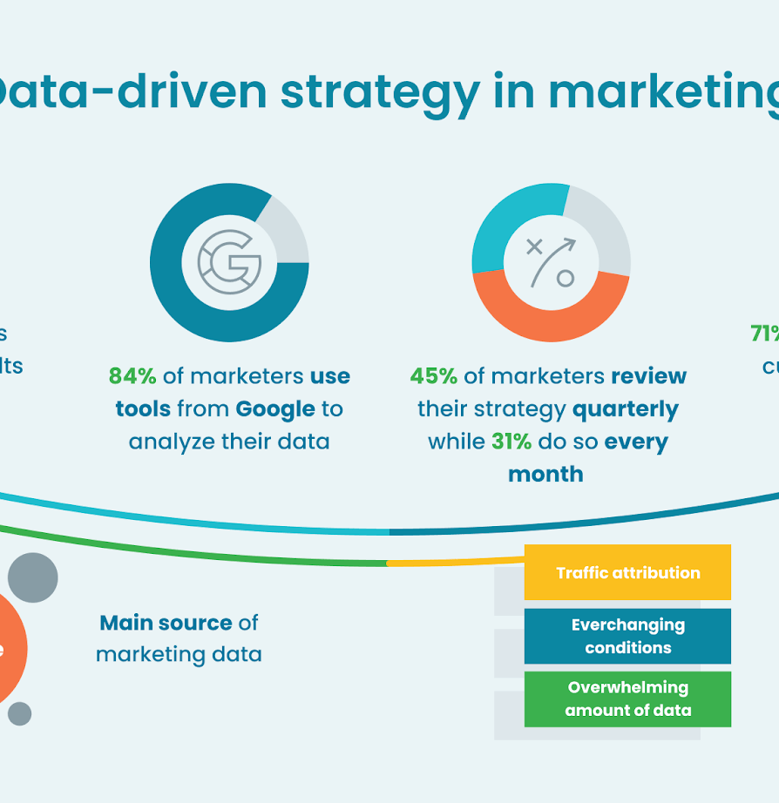
Final Conclusion
The analysis provides a comprehensive framework for understanding promotional dynamics and equips the client with data-driven insights to optimize future marketing strategies. Key findings reveal that promotions have a significant but highly variable impact on sales, with fast-moving products and stores exhibiting stronger relative uplift. Predictive models can capture these non-linear patterns but struggle to fully anticipate extreme promotional spikes.

Slide 37
THANKS FOR LISTENING

